Slide 1
Cloud Computing
SEWP ZG527

Slide 2
Introduction to Cloud Computing, services and deployment models
Agenda
Introduction to Cloud Computing – Origins and Motivation
3-4-5 rule of Cloud Computing
Types of Clouds and Services
Cloud Infrastructure and Deployment

Slide 3
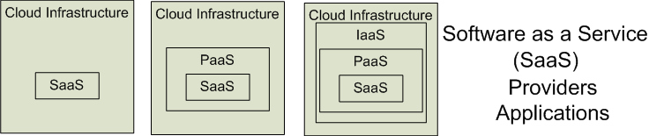

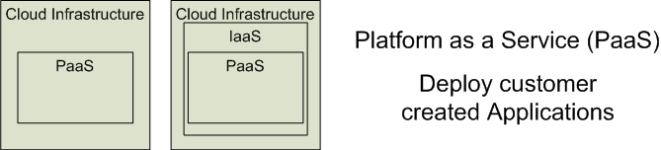

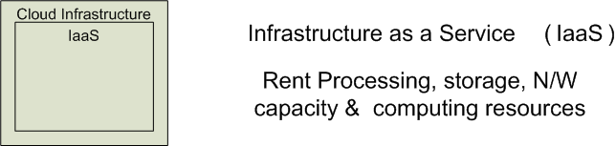


3 Cloud Service Models
Software as a Service (SaaS)
Platform as a Service (PaaS)
Infrastructure as a Service (IaaS)
SalesForce CRM
LotusLive
Google App Engine
Notes:
RL 1.3

Slide 4
Software as a Service (SaaS)
Software as a service features a complete application
offered as a service on demand.
A single instance of the software runs on the cloud
and services multiple end users or client organizations.
E.g. salesforce.com , Google Apps

Slide 5
Platform as a Service
Platform as a service encapsulates a layer of software and provides it as a service that can be used to build higher-level services.
2 Perspectives for PaaS :-
1. Producer:- Someone producing PaaS might produce a platform by integrating an OS, middleware, application software, and even a development environment that is then provided to a customer as a service.
2. Consumer:-Someone using PaaS would see an encapsulated service that is presented to them through an API. The customer interacts with the platform through the API, and the platform does what is necessary to manage and scale itself to provide a given level of service. Virtual appliances can be classified as instances of PaaS.

Slide 6
Infrastructure as a Service
Infrastructure as a service delivers basic storage and computing capabilities as standardized services over the network.
Servers, storage systems, switches, routers , and other systems are pooled and made available to handle workloads that range from application components to high-performance computing applications.

Slide 7
Service Models Summary
Cloud Software as a Service (SaaS)
The capability provided to the consumer is to use the provider’s applications running on a cloud infrastructure and accessible from various client devices through a thin client interface such as a Web browser (e.g., web-based email). The consumer does not manage or control the underlying cloud infrastructure, network, servers, operating systems, storage, or even individual application capabilities, with the possible exception of limited user-specific application configuration settings.
Cloud Platform as a Service (PaaS)
The capability provided to the consumer is to deploy onto the cloud infrastructure consumer-created applications using programming languages and tools supported by the provider (e.g., Java, Python, .Net). The consumer does not manage or control the underlying cloud infrastructure, network, servers, operating systems, or storage, but the consumer has control over the deployed applications and possibly application hosting environment configurations.
Cloud Infrastructure as a Service (IaaS)
The capability provided to the consumer is to rent processing, storage, networks, and other fundamental computing resources where the consumer is able to deploy and run arbitrary software, which can include operating systems and applications. The consumer does not manage or control the underlying cloud infrastructure but has control over operating systems, storage, deployed applications, and possibly select networking components (e.g., firewalls, load balancers).
.

Slide 8
Cloud Infrastructures
Key Technology is Virtualization
App
App
App
App
App
App
OS
OS
OS
Operating System
Hypervisor
Hardware
Hardware
Traditional Stack
Virtualized Stack
Virtualization plays an important role as an enabling technology for datacentre implementation by abstracting compute, network, and storage service platforms from the underlying physical hardware
Notes:
Virtualization is simulating a hardware platform, operating system, storage device or network resources

Slide 9
Cloud Providers Characteristics
Provide on-demand provisioning of computational resources
Use virtualization technologies to lease these resources
Provide public and simple remote interfaces to manage those resources
Use a pay-as-you-go cost model, typically charging by the hour
Operate data centers large enough to provide a seemingly unlimited amount of resources to their clients

Slide 10
Management of Virtualized Resources
Distributed Management of Virtual Machines
Reservation-Based Provisioning of Virtualized Resources
Provisioning to Meet SLA Commitments
Notes:
Distributed Management of Virtual Machines
Managing VMs need to set up custom software environments for VMs, setting up and managing networking for interrelated VMs, and reducing the various overheads involved in using VMs. Thus, VI managers must be able to efficiently orchestrate all these different tasks.
Reservation-Based Provisioning of Virtualized Resources
Determination of the demand for resources is known beforehand so that the computational resources must be available at exactly that time to process the data produced by the equipment
Provisioning to Meet SLA Commitments
IaaS clouds can be used to deploy services that will be consumed by users other than the one that deployed the services. cloud providers are typically not directly exposed to the service semantics or the SLAs that service owners may contract with their end users. The capacity requirements are, thus, less predictable and more elastic.

Slide 11
Cloud Infrastructure Anatomy
The key component of an IaaS cloud architecture is the cloud OS, which manages the physical and virtual infrastructures and controls the provisioning of virtual resources according to the needs of the user services
A cloud OS’s role is to efficiently manage datacenter resources to deliver a flexible, secure, and isolated multitenant execution environment for user services that abstracts the underlying physical infrastructure and offers different interfaces and APIs for interacting with the cloud
While local users and administrators can interact with the cloud using local interfaces and administrative tools that offer rich functionality for managing, controlling, and monitoring the virtual and physical infrastructure, remote cloud users employ public cloud interfaces that usually provide more limited functionality

Slide 12
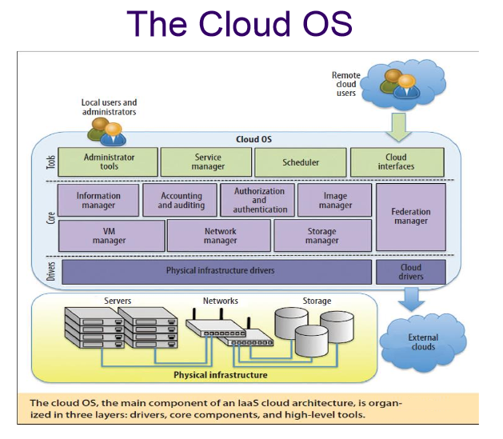
The cloud operating system is responsible for:
1. managing the physical and virtual infrastructure,
2. orchestrating and commanding service provisioning and deployment
3. providing federation capabilities for accessing and deploying virtual resources in remote cloud infrastructures

